Slide 1





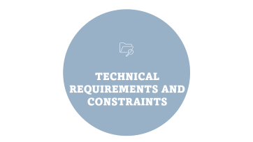
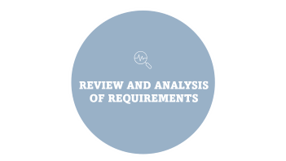


SOFTWARE REQUIREMENTS SPECIFICATION DOCUMENT
Presented by group 6
Instructor: Dr, Nkemeni Valery

Slide 2

INTRODUCTION

Slide 3


INTRODUCTION
This document provides a detailed description of the software requirements of the system.

Slide 4

REVIEW AND ANALYSIS OF REQUIREMENTS

Slide 5
REVIEW AND ANALYSIS OF REQUIREMENTS

Slide 6

IDENTIFYING INCONSISTENCIES AND MISSING
INFORMATION

Slide 7
IDENTIFYING INCONSISTENCIES
AND MISSING INFORMATION

Slide 8

REQUIREMENTS

Slide 9
FUNCTIONAL AND NON-FUNCTIONAL REQUIREMENTS

Slide 10
TECHNICAL REQUIREMENTS AND CONSTRAINTS

Slide 11
TECHNICAL REQUIREMENTS AND PROJECT CONSTRAINTS
Mobile Application Platform and Permissions
Background Services
Backend and Database
Project Constraints

Slide 12

ESTIMATED COST

Slide 13

ESTIMATED COST

Slide 14

CONCLUSION

Slide 15
CONCLUSION

